Slide 1
Focal Self-attention for Local-Global Interactions in Vision Transformers
Microsoft Research Redmond | Microsoft Cloud + AI NeurIPS 2021

Slide 2
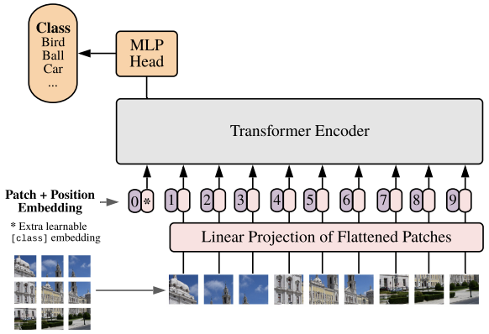
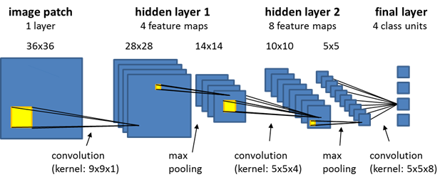
What makes ViTs work?
Long range interactions
Model local (like CNNs) and global visual dependencies.
Convolutional Neural Network
Vision Transformer (ViT)

Slide 3
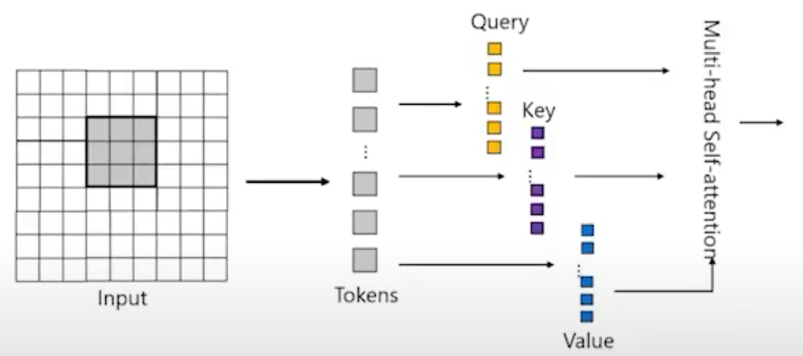
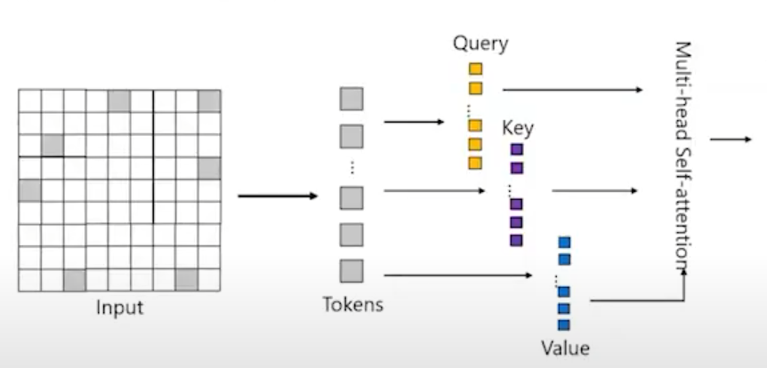
What makes ViTs work?
Dynamic “token” self-attention
Adaptive computation and flexible selection
Modeling local interaction for input inside a grid
Modeling interaction for input at arbitrary distributions

Slide 4
What makes ViTs work?
Lower floor but higher ceiling
CNNs’ strong inductive biases help them reach high performance even with minimal data (high floor) but may limit them when with large quantities of data (low ceiling).
Transformers’ minimal inductive biases can be limiting in small data settings (low floor) but can enable them to outperform CNNs in large data regimes, with sufficient data augmentation and regularization (high ceiling).

Slide 5
Challenges for ViTs
How to model long-range interactions for high resolution input?
Cope with quadratic computational & memory cost of self-attention (w.r.t the number of grids in feature maps)
Best of both world: locality and globality
Alternatively exploiting either coarse-grained global self-attention or fine-grained local self-attention (i.e., Swin) weakens the power of the full self-attention -> Sub-optimal solution.
→ Important for dense visual tasks: object detection, semantic segmentation.

Slide 6
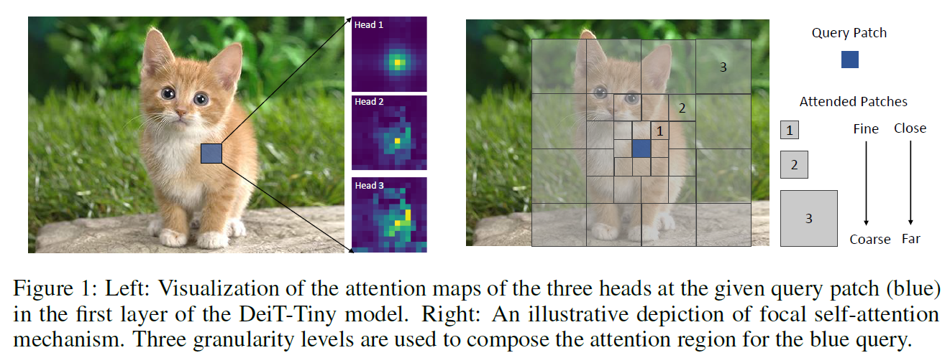
Focal Attention for Best of Both Worlds
Models both short- and long-range interactions.
By fine-grained local attention + coarse-grained global attention.
Notes:
A query token in the feature map attends its closest surroundings at the finest granularity as itself. However, when it goes to farther regions, it attends to summarized tokens to capture coarse-grained visual dependencies. The further away the regions are from the query, the coarser the granularity is.
DeiT = Data-Efficient Image Transformer

Slide 7
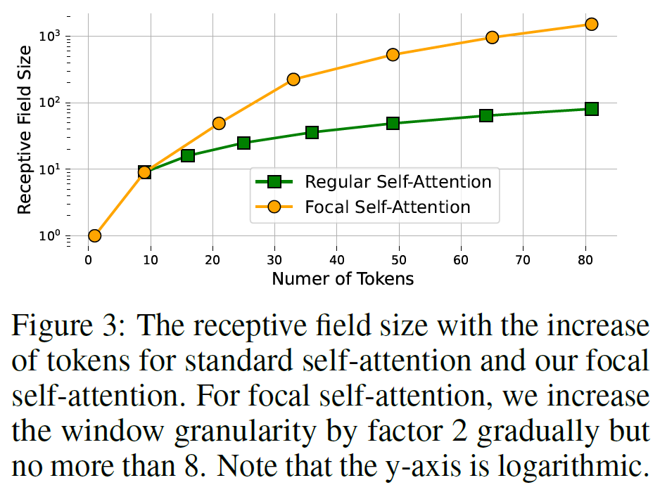
Focal Attention Receptive Field
Focal Attention has a much larger receptive field than regular Self-Attention using same number of tokens

Slide 8
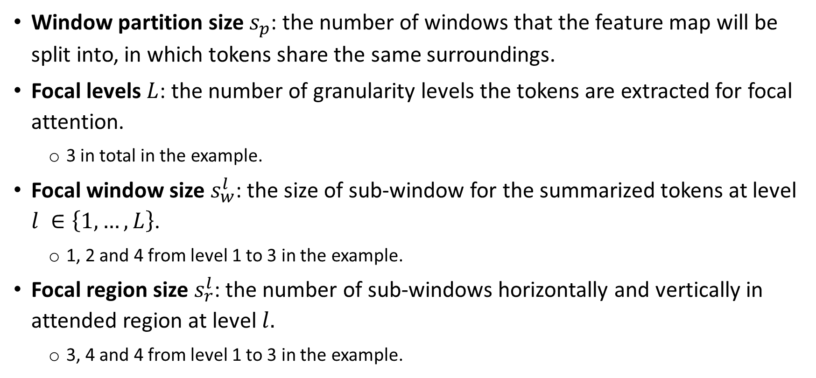
Focal Attention Mechanism
Window partition size $s_{p}$: the number of windows that the feature map will be split into, in which tokens share the same surroundings.
Focal levels $L$: the number of granularity levels the tokens are extracted for focal attention.
3 in total in the example.
Focal window size $s_{w}^{l}$: the size of sub-window for the summarized tokens at level $l ∈\left\{1,…,L\right\}$.
1, 2 and 4 from level 1 to 3 in the example.
Focal region size $s_{r}^{l}$: the number of sub-windows horizontally and vertically in attended region at level $l.$
3, 4 and 4 from level 1 to 3 in the example.

Slide 9
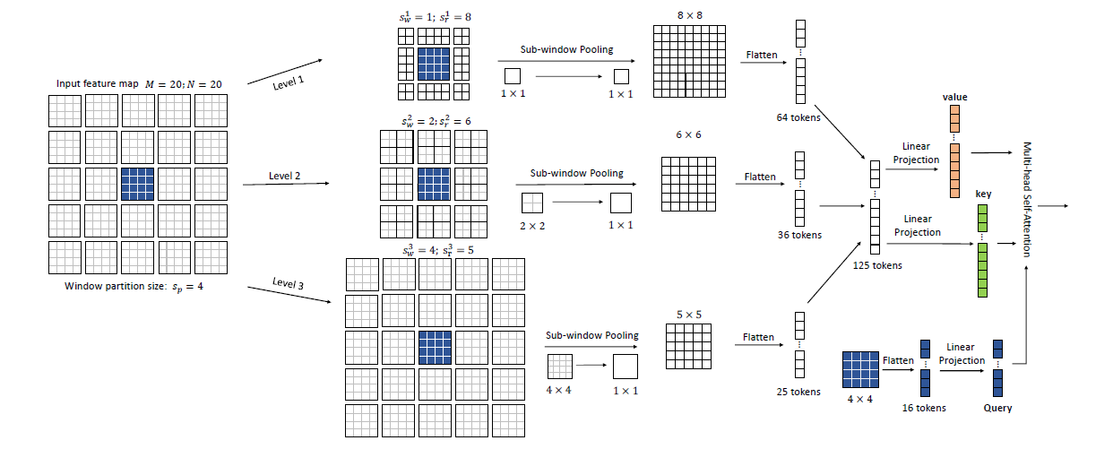
Focal Attention Mechanism
An Illustration of Focal Self-Attention at Window Level
Notes:
Note that a strict version of focal self-attention following Fig. 1 requires to exclude the overlapped regions across different levels. In our model, we intentionally keep them in order to capture the pyramid information for the overlapped regions.

Slide 10
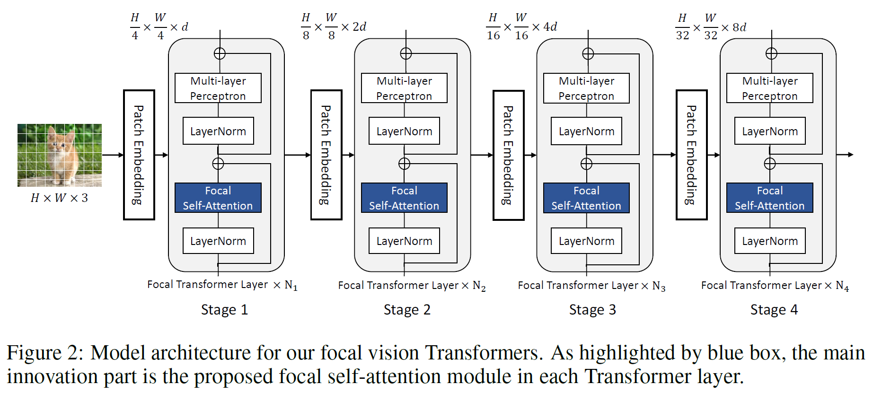
Focal Transformers

Slide 11
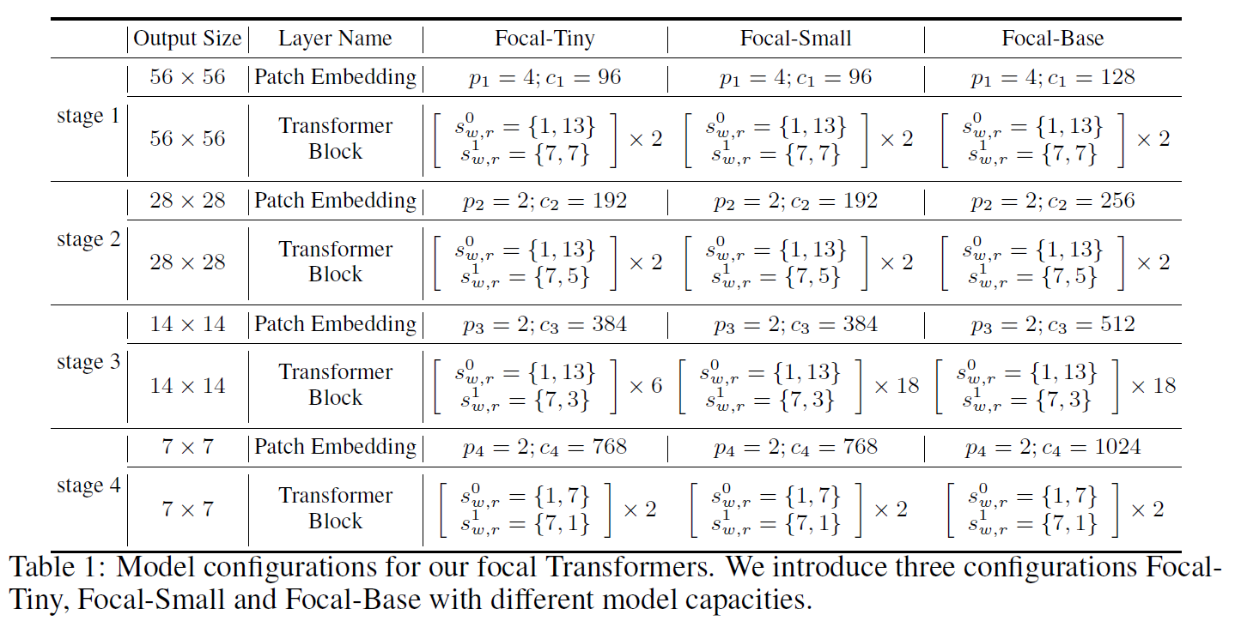
Focal Transformers Model Configs

Slide 12
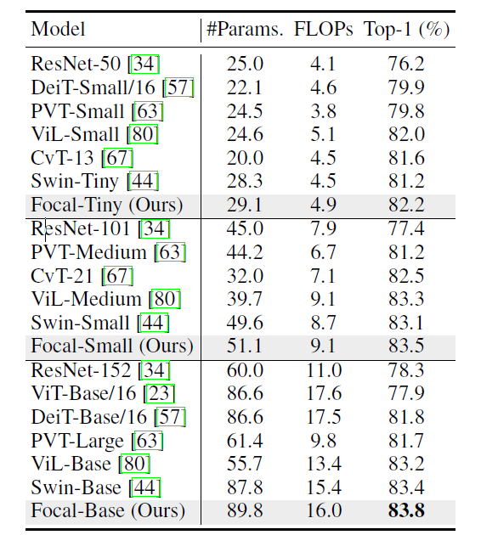
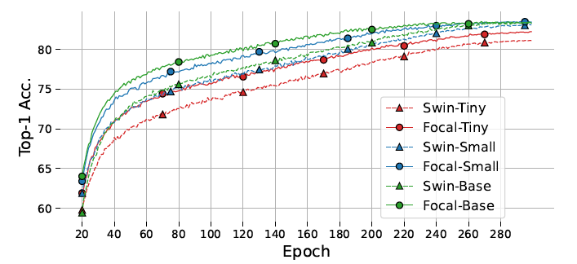
Experiments: Image Classification
Training curves for Focal Transformers and Swin Transformers
Focal Transformers outperform ResNet counterparts and other SOTA ViTs
Focal Transformers have much faster convergence speed than Swin Transformers
Top-1 Acc. On ImageNet-1k

Slide 13
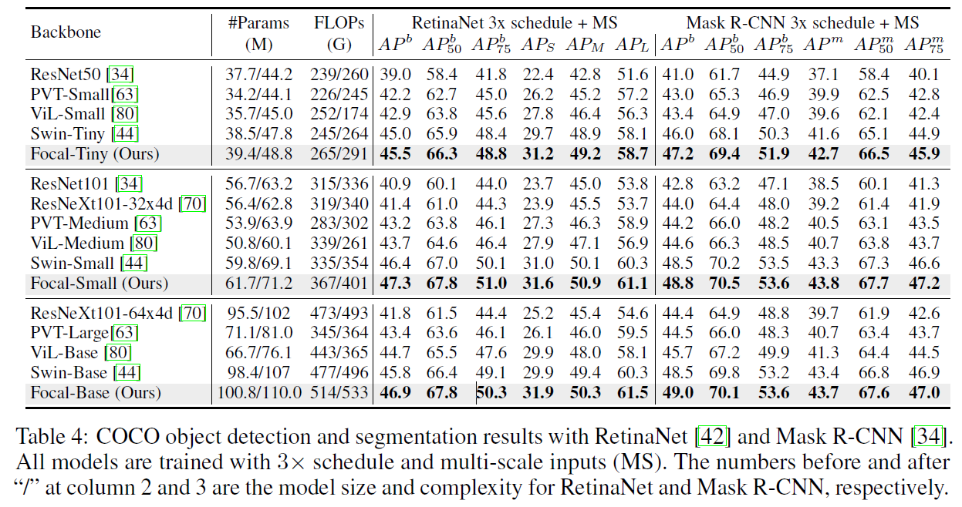
Experiments: Object Detection
Notes:
2 training schedules, 1x schedule with 12 epochs and 3x schedule with 36 epochs. For 1x schedule, we resize image’s shorter side to 800 while keeping its longer side no more than 1333. For 3x schedule, we use multi-scale training strategy by randomly resizing its shorter side to the range of [480; 800].

Slide 14
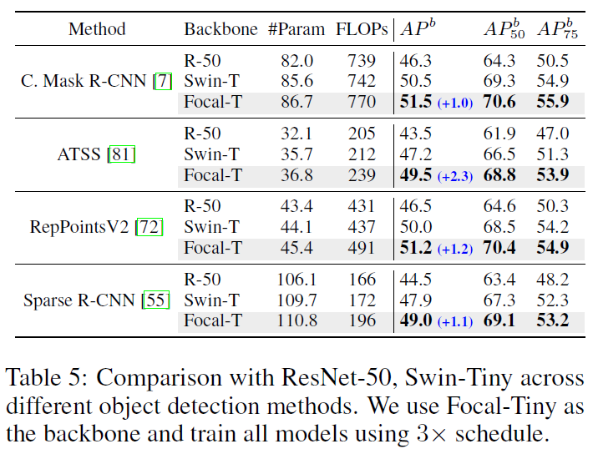
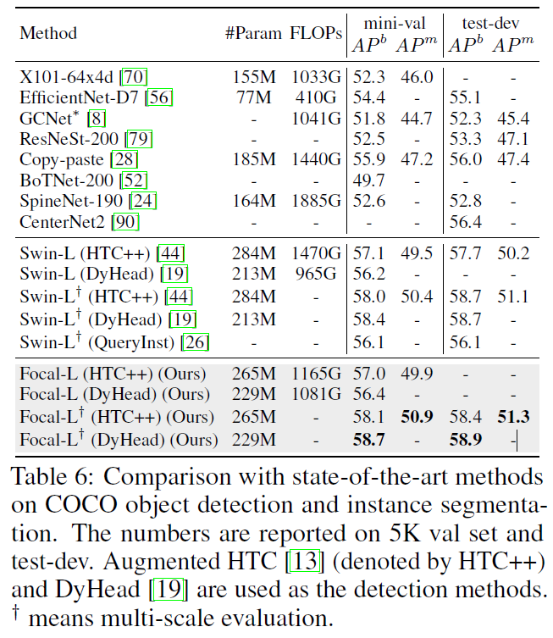
Experiments: Object Detection

Slide 15
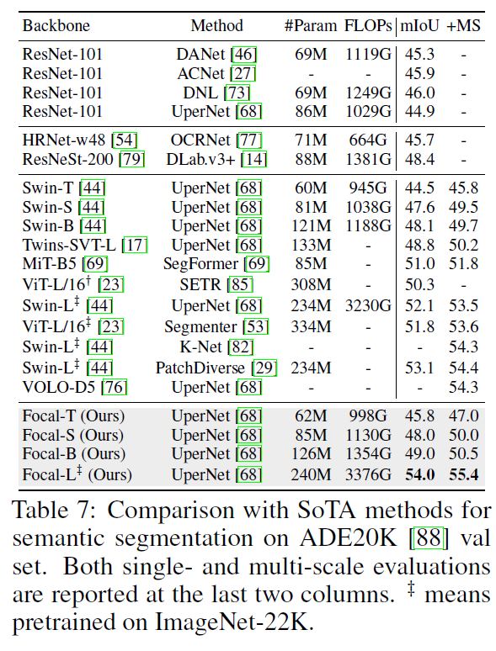
Experiments: Semantic Segmentation

Slide 16
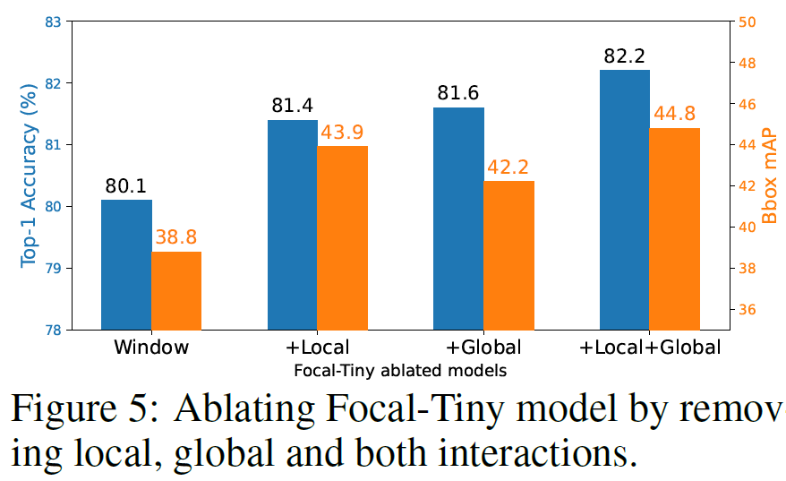
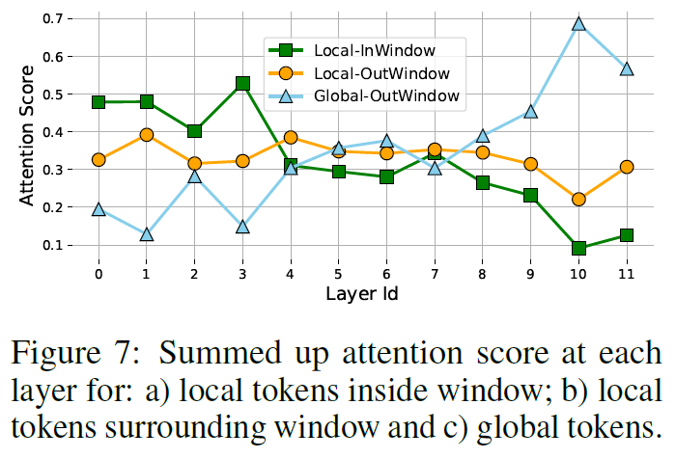
Importance of Local and Global Interactions
Notes:
A clear trend that the global attention becomes stronger when it goes to upper layers, while the local attention inside a window is weakened gradually. This indicates that:
The model heavily relies on both short- and long-range interactions. Neither of them are neglected in the model at all layers and stages;
The gradually strengthened global and weakened local attentions indicate that model tends to focus on more local details at earlier stages while on more global context at the later stages.

Slide 17
Conclusion
Proposed focal attention which effectively models short- and long-range visual interactions.
Can be utilized with other scaling techniques (i.e., Swin V2).

Slide 18
Thank you for listening

